Slide 1



OBJECT ORIENTED PROGRAMMING
VOICE ASSISTANT
SHREYA GUPTA
BT21ECE061
SUBMITTED TO: DR VIPIN KAMBLE
JEEVESH PATHAK BT21ECE092
ANURAG SAHU BT21ECE093 DRISHTI DIWANI BT21ECE120

Slide 2


AIM
THE AIM OF THE PROJECT IS TO USE FUNDAMENTAL PYTHON CONCEPTS AND LIBRARIES TO MAKE A SIMPLE VOICE ASSISTANT
THE PROJECT DEMONSTRATE MAINLY THE USE OF SPEECH RECOGNITION FOR RECOGNISING HUMAN VOICE INPUT, PYTTSX3 FOR TEXT TO SPECH CONVERSION (FOR REPLIES BY THE VOICE ASSISTANT) AND PYQT5 FOR GRAPHICAL USER INTERFACE

Slide 3
CODE INSIGHTS
MAINLY USED PYTHON LIBRARIES USED
SPEECH RECOGNITION
PYTTSX3
PYWHATKIT
PYQT5
WEB BROWSER
SEVERAL OTHER LIBRARIES SUCH AS TIME, SOUND DEVICE ETC.

Slide 4

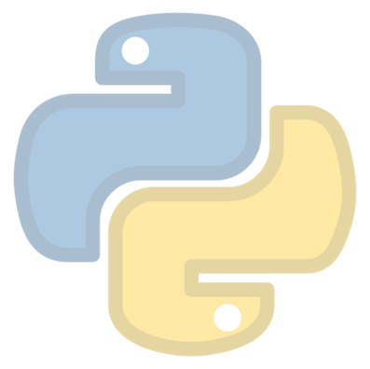
FUTURE SCOPE
THE PROJECT COULD BE FURTHER EXTENDED ON THE BASIS OF FUTHER DATA AVAILABLE BASED ON VOCABULARY AND LOCAL SPEAKING STYLES.
VOICE ASSITANT IN THE FUTURE COULD BE IMPLEMENTED WITH LOCAL DIALECTS SO EVEN RURAL PEOPLE WHO COULDN'T INTERACT WITH MOBILE OR OTHER DEVICES COULD USE MOBILE TECHNOLOGIES.
BY INTEGRATION WITH ARTIFICIAL INTELLIGENCE THE ASSITANT COULD BE FURTHER MADE INTELLIGENT TO BE ABLE TO CONVERSE WITH PEOPLE.

Slide 5
REFERENCES

Slide 6
TThhhaaannnkkk
yyooouuu!!!

